Slide 1


Team 28: Guitar Entertainment System
Bi-Weekly Update 2 Rishabh Ruikar, Monte Martin III, Rawan Ibraheem Sponsor: Souryendu Das (TA)
Notes:
Rawan

Slide 2
Project Summary
Problem Statement: Current guitar amplifiers and effects systems often present a steep learning curve, deterring those with limited technical experience from fully exploring their sound potential.
Solution proposal: Developing a user-centric guitar sound system, combining an amp, pedals, and a Bluetooth-connected app. This system simplifies sound customization through intuitive controls and presets, making advanced sound manipulation accessible to all skill levels.
Notes:
Rishabh

Slide 3
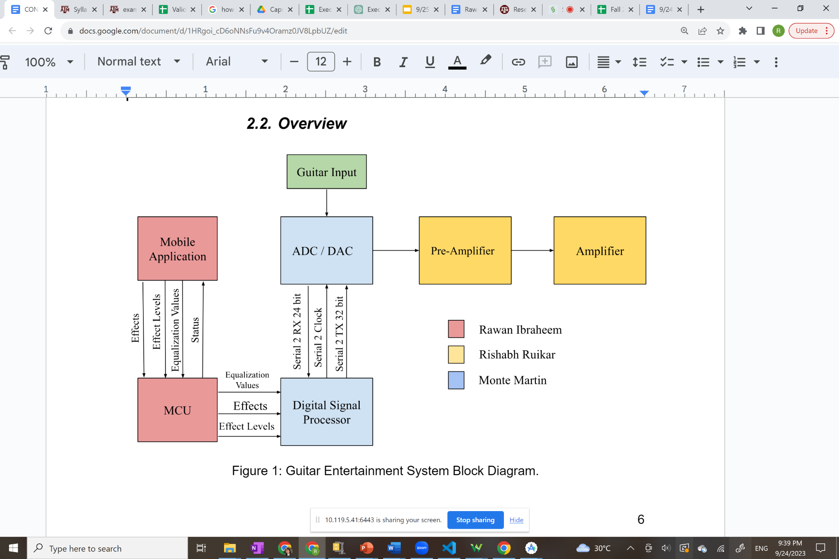
Project/Subsystem Overview
Figure 1: Subsystem overview.
Notes:
Monte

Slide 4
Project Timeline
Subsystem Redesign (Amplifier; completed 1/26) | Pedal System tweaks (completed on 2/6) | Subsystem Redesign (App and Pedal System; to be complete by 2/20) | System integration (to be complete by 3/15) | Finish Housing (to be complete by 4/1) | Validation (to be complete by 4/10)
Notes:
Rawan

Slide 5
Subsystem 1: Amplifier
Rishabh
Accomplishments since last presentation 6 hrs of effort | Ongoing progress/problems and plans until the next presentation
New boards have been received First set of parts has been received Stencil has been received Housing design process has started | Test that preamplifier is able to achieve at least a 10dB gain from 3 types of sine waves- 50Hz(bass), 1kHz (mid), 5kHz (treble), this will be in preparation to integrate with pedal system

Slide 6
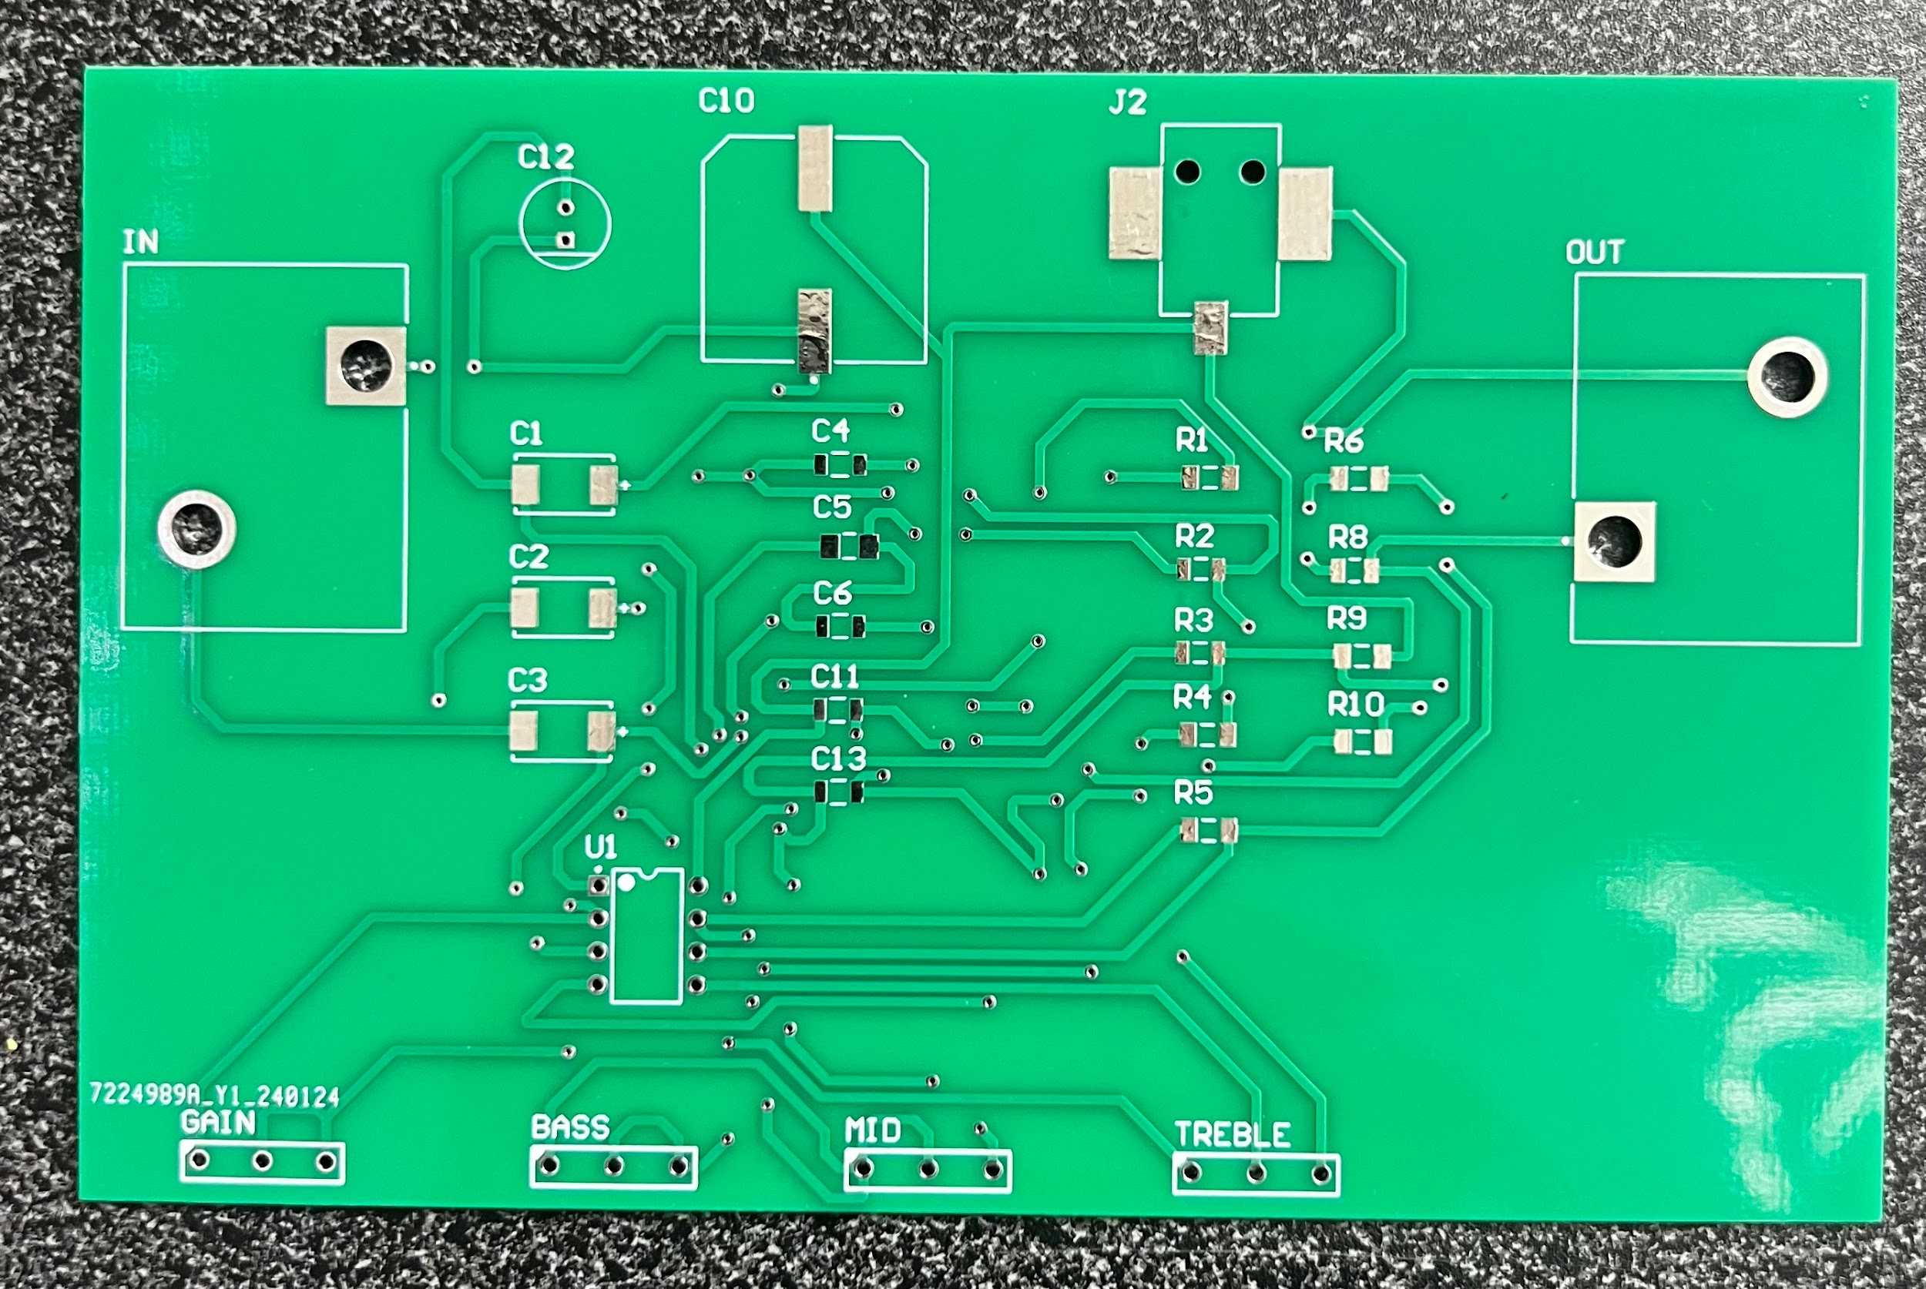
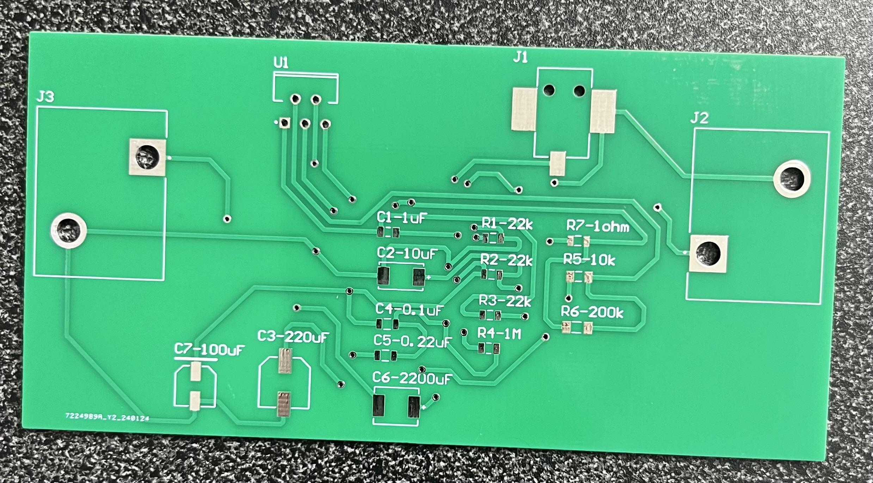
Subsystem 1: Amplifier
Rishabh Ruikar
Figure 1: Preamplifier PCB
Figure 2: Amplifier PCB
Boards received on 2/2
First set of parts received on 2/5
All parts will be in hand by 2/16

Slide 7
Subsystem 2: Pedal System
Monte Martin
Accomplishments since last presentation 40 hrs of effort | Ongoing progress/problems and plans until the next presentation
Completed redesign of ADC filtering in preparation for integration with guitar and amp | Ongoing integration of pedal and app subsystems Working on revised design PCB layout Implementing failsafes into the design to prevent the need of a 2nd revision

Slide 8
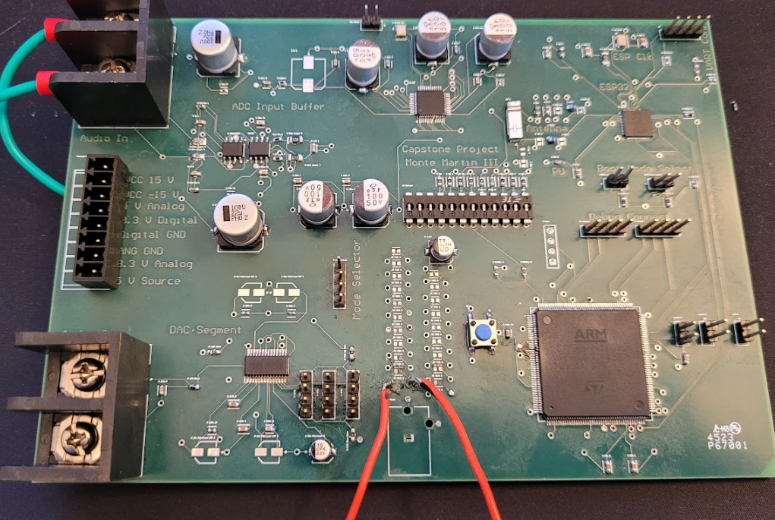
Subsystem 2: Pedal System
Monte Martin
Figure 4: Current board used for testing the ADC, DSP, and DAC.
Redesign will be finished and ordered 2/9
Mounted with the incorrect orientation, will be fixed and tested on 2/8

Slide 9
Subsystem 3: Bluetooth App
Rawan Ibraheem
Accomplishments since last presentation 18 hrs of effort | Ongoing progress/problems and plans until the next presentation
No accomplishments | Program UART communication between STM32 and ESP32 to integrate pedal and application subsystems Program guitar sound effects (delay, chorus, reverb) on STM32 Goals: Establish communication between STM32 and ESP32. Program distortion and reverb sound effects onto incoming PCM data.

Slide 10
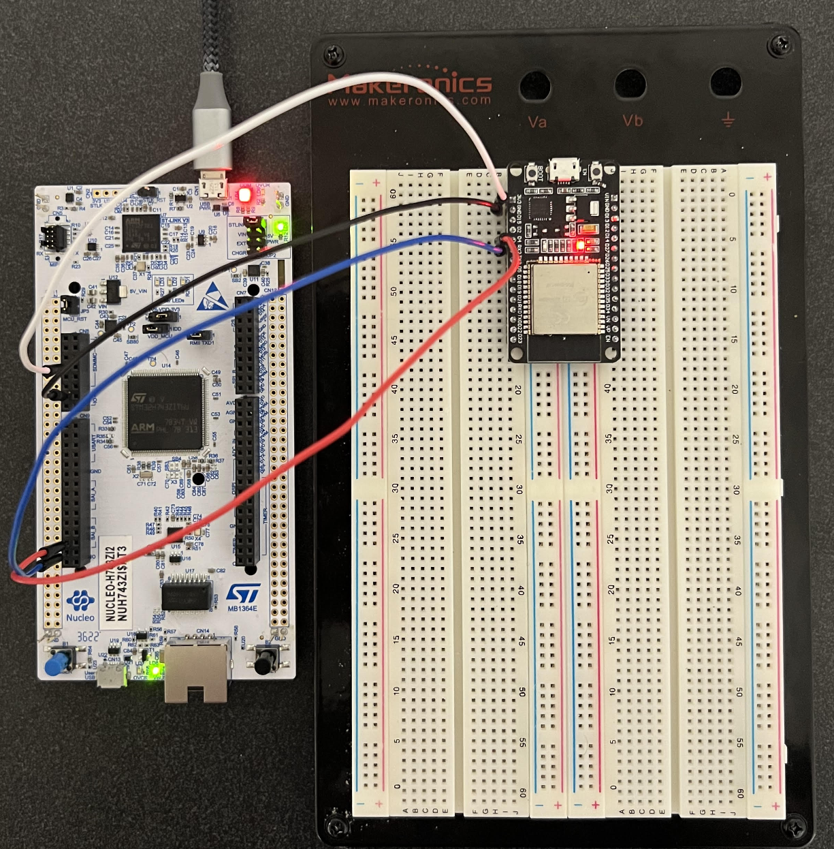
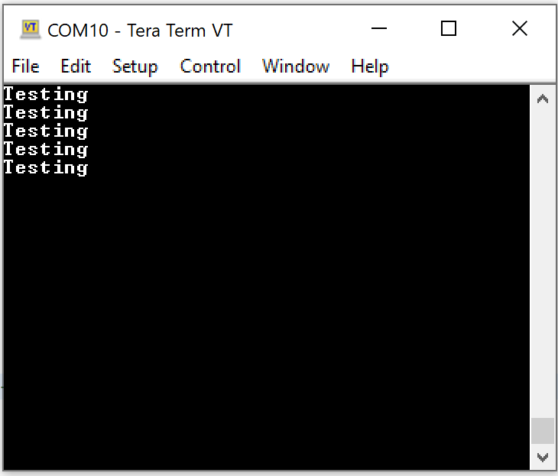
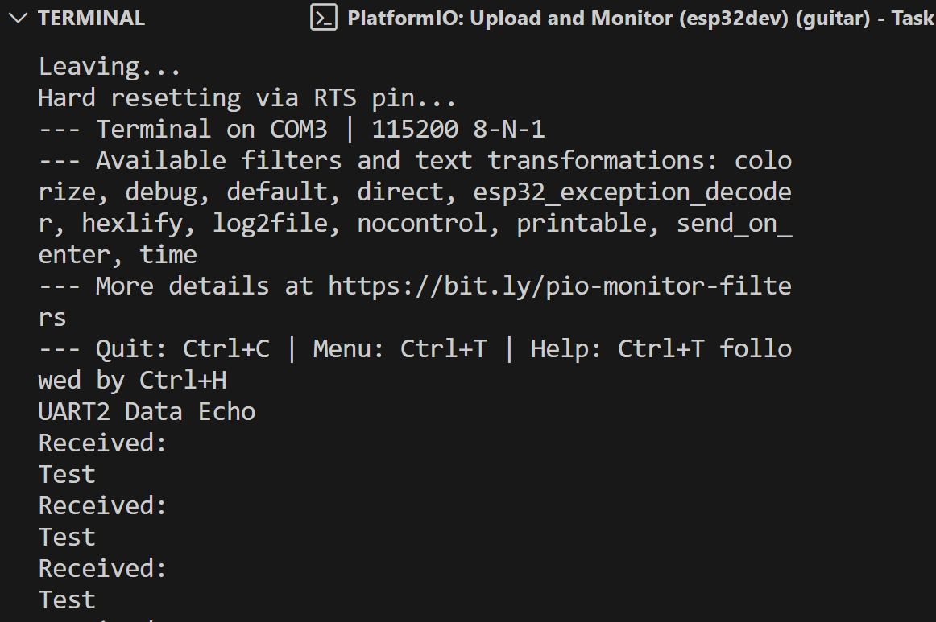
Subsystem 3: Bluetooth App
Rawan Ibraheem
Figure 6: Testing STM32 communication through USB (computer). This will be used to send and receive PCM data.
Figure 7: Testing UART communication on ESP32. Rx and Tx pins connected.
Figure 5: UART communication between STM32 and ESP32.

Slide 11
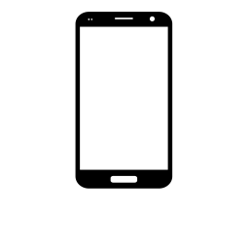
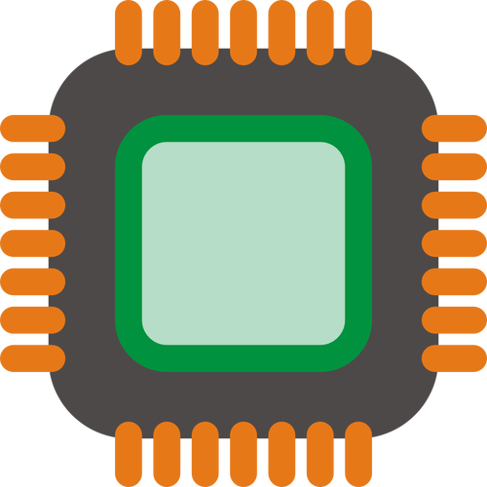

Subsystem 3: Bluetooth App
Rawan Ibraheem
Application
STM32
ESP32
x
Figure 8: Overview of MCU Integration.

Slide 12
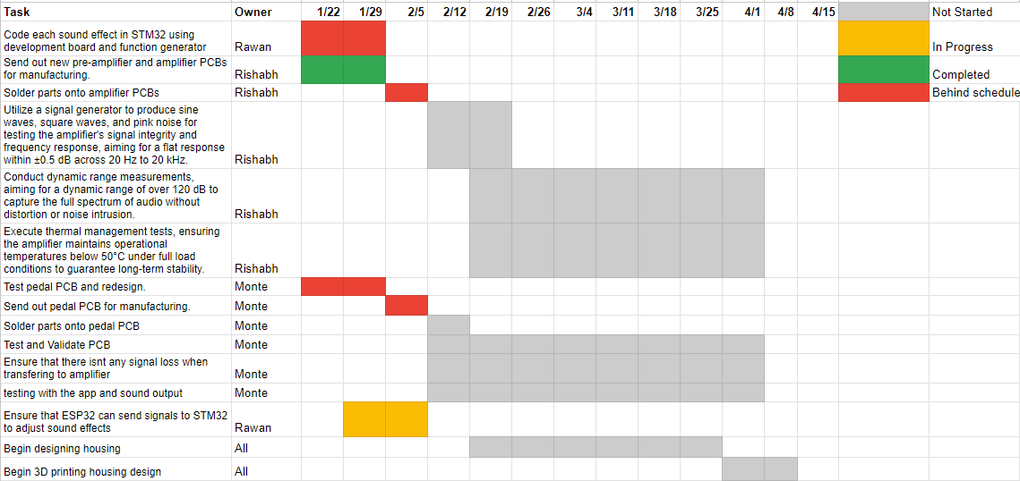
Execution Plan
Notes:
Michelle

Slide 13
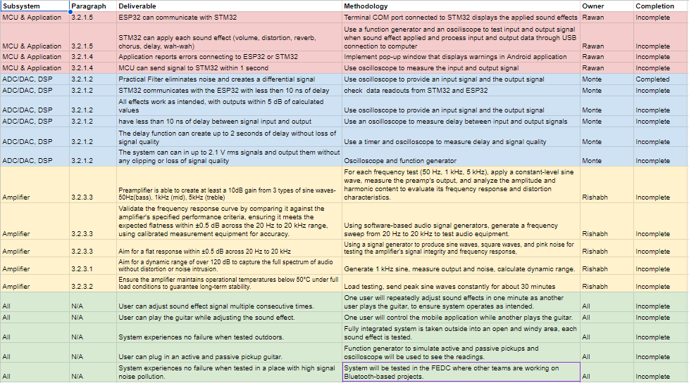
Validation Plan

Slide 14

Thank you for listening.

